Slide 1
Online News Popularity
Vladimir Bykov

Slide 2
Problem definition
Is it possible to predict a popularity of an online publication (a number the article will be shared among users) based on the data about its content?

Slide 3
Dataset
Dataset (61 columns and 39644 rows) from UCI online repository for machine learning
Data are characteristics of text, such as:
- length of text, title
- keywords
- images, video
- negative, positive words, degree of polarity
- sentiment polarity. Sentiment polarity for an element defines the orientation of the expressed sentiment, i.e., it determines if the text expresses the positive, negative or neutral sentiment of the user about the entity in consideration
- target variable: number of times an article was shared

Slide 4
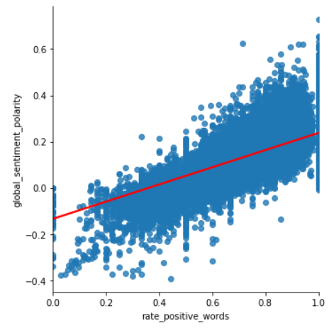
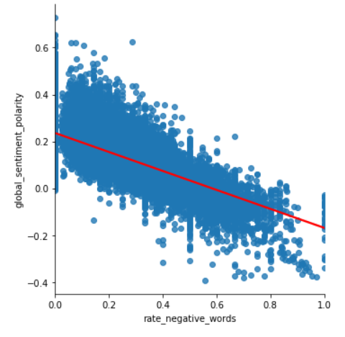
Correlation between some parameters: global sentiment polarity vs rate of positive and negative words
Global sentiment polarity changes it's sign depending whether positive or
negative words were used

Slide 5
Relationship between target variable and the data?
Correlation matrix strategy failure: highest correlation coefficient 0.11, meaning R^2 = 0.012 or only 1.2% of variance in the target variable can be explained by this feature (kw_avg_avg = average keyword).
Predictive power score matrix: no better
Conclusion: no any strong predictor, a lot of small contributors to the prediction of target variable. Regression model might be useless in such situation

Slide 6
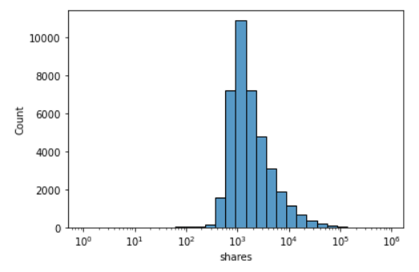
Distribution of the target variable (shares)
Dividing target variable into 5 classes based on how many times an article was shared online (bad, low, medium, high, v_high)

Slide 7
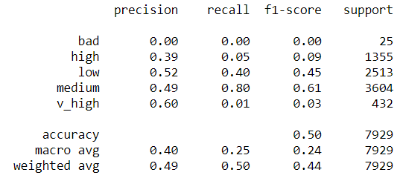
Classification models: round I target variable divided into 5 classes
Accuracy score base line set on highest class (medium): 0.45
Score of the models:
DecisionTreeClassifier: 0.39
RandomForestClassifier: 0.505
KneighborsClassifier: 0.425
SVC: 0.501
GaussianNB: 0.24
MultinomialNB: nan
AdaBoostClassifier: 0.486
GradientBoostingClassifier: 0.514
Model beats the baseline, but poor score of predicting lousy articles, zero to be exact
RandomForest: test
Hyperparameters: criterion: gini, max_depth: None, n_estimators: 200

Slide 8
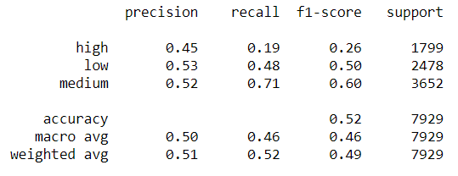
Classification models: round II target variable divided into 3 classes
Accuracy score base line set on highest class (medium): 0.45
Score of the models
DecisionTreeClassifier: 0.419
RandomForestClassifier: 0.512
KneighborsClassifier: 0.439
SVC: 0.509
GaussianNB: 0.418
MultinomialNB: nan
AdaBoostClassifier: 0.513
More fair prediction precision among the groups, model beats the base line
RandomForest: test
Hyperparameters: criterion: entropy, max_depth: None, n_estimators: 200

Slide 9
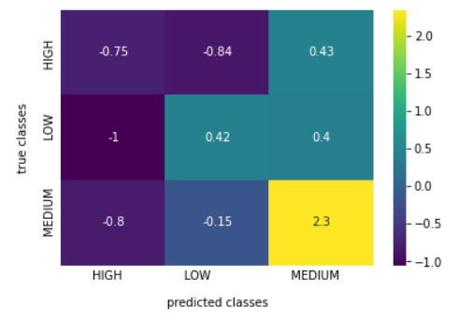

Predictions: confusion matrix
df_norm_col=(cm-cm.mean())/cm.std()
True MEDIUM class will be classified as MEDIUM (GOOD)
True LOW class mostly will be classified as LOW and will be splilled into MEDIUM (OK)
23% of HIGH class will be classified as HIGH, 18% as LOW, rest as MEDIUM (poor)

Slide 10
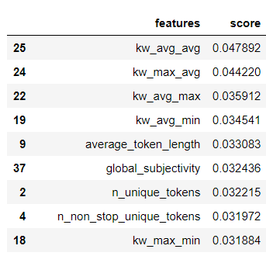
Contribution of different features to prediction:
How different features explain variation in the target variable
Keywords seems to bare highest weight of prediction.
Same dominant feature as in correlation matrix where it explains only 0.01% variance, now 0.05%

Slide 11
Query to the data collection
There is no any good predictor of target variable in the dataset.
A popularity of an article depends on how timely publication is, let say writing something about corona viruses before COVID19 pandemic will be scarecely noticed online.
On contrary, when a publication is in the mainstream news it will be widely shared. This type of parameter could be a good choice for data collection aiming at predicting articles popularity.

Slide 12
Challenges:
poor scores, lack of strong predictors, model optimization only partially helpful
Learnings / highlights:
re-grouping dataset, selection of different models, data interpretation

Slide 13
Conclusions
The developed model of RandomForest predicts popularity of online publications with accuracy better than a random prediction.
The dataset will benefit from adding extra parameters describing timeness of a publication

Slide 14
Thank you

